Slide 1
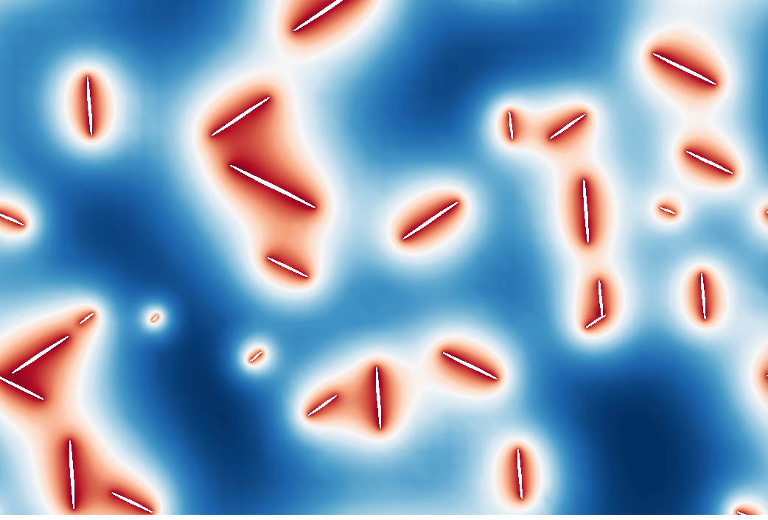
The PRISMS Phase Field Code
Trainers:
Steve DeWitt
David Montiel
Jason Luce

Slide 2
Training Objective
Learn enough of PRISMS-PF to allow you to go home and start using it in your work

Slide 3
Plan for the Training
Schedule:
Brief introductory comments
Guided walkthrough with exercises interspersed
Tour of the file system
Running example applications
Visualization
Tutorial on writing equations in the weak form
Walkthrough of the application files
Dedicated time for individual exercises using PRISMS-PF to modify existing applications and create new applications
Now
Today
Wednesday

Slide 4
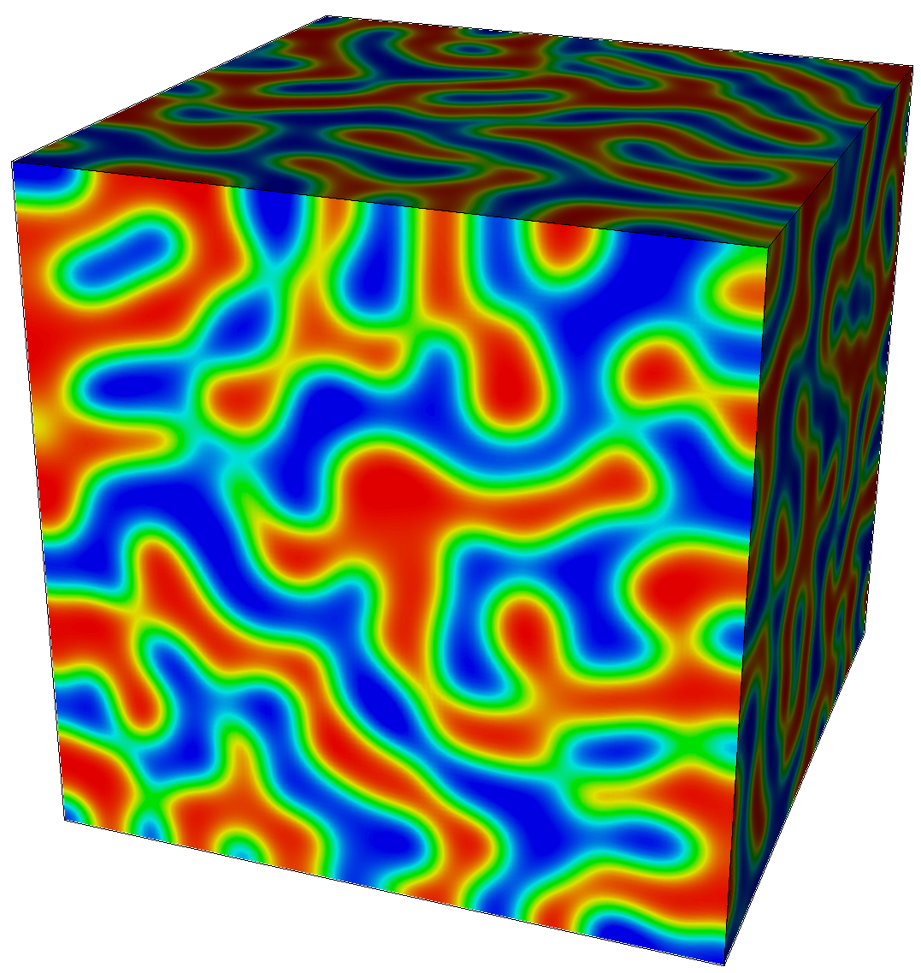

One Slide on Phase Field Modeling
Diffuse interface approach to modeling microstructure evolution
Used to study phase separation in systems with 2+ free energy minima
Evolution equations derived from a free energy functional
May or may not have a physical basis
Applications include:
solidification, precipitation, grain growth, phase separation in batteries, deposition, ferroics
Allen-Cahn Equation
(non-conserved dynamics)
Cahn-Hilliard Equation
(conserved dynamics)
Spinodal Decomposition
(Cahn-Hilliard Equation)

Slide 5
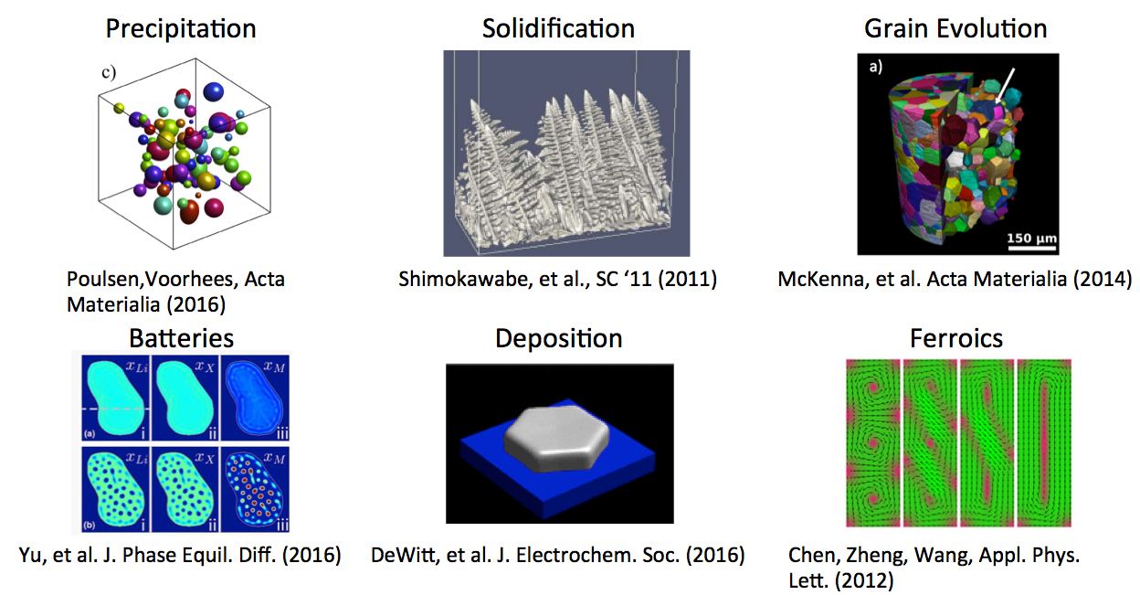
Motivation: What’s hard about writing a phase field code?
Wide diversity of models and coupled physics makes code reuse difficult
No real “typical” governing equations
Large variety of formulations and terms

Slide 6
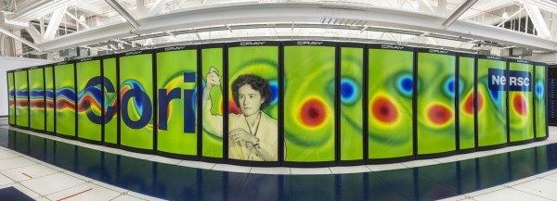
Motivation: What’s hard about writing a phase field code?
Simulating large, physically representative systems is computationally intensive
Simulations often take days on 10s-100s of cores
Simulations are often done in 2D for tractability
Physical fidelity requires strong numerical performance
nersc.gov

Slide 7

Four Principles Guiding PRISMS-PF Development
Its computational performance, including parallel scalability, should meet or exceed that of typical phase field codes
It should accommodate a wide variety of phase field models and applications
The interface for creating or modifying governing equations should be simple, quick, and separate from the numerics
It should be open source with a permissive license so it is available to everyone and advances can be shared by the community

Slide 8
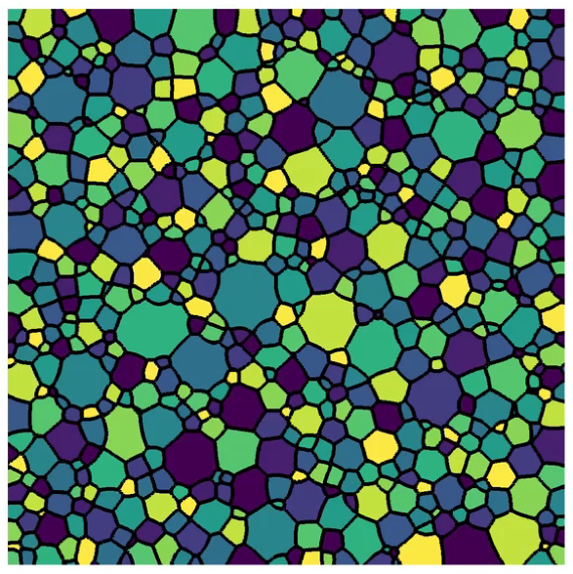
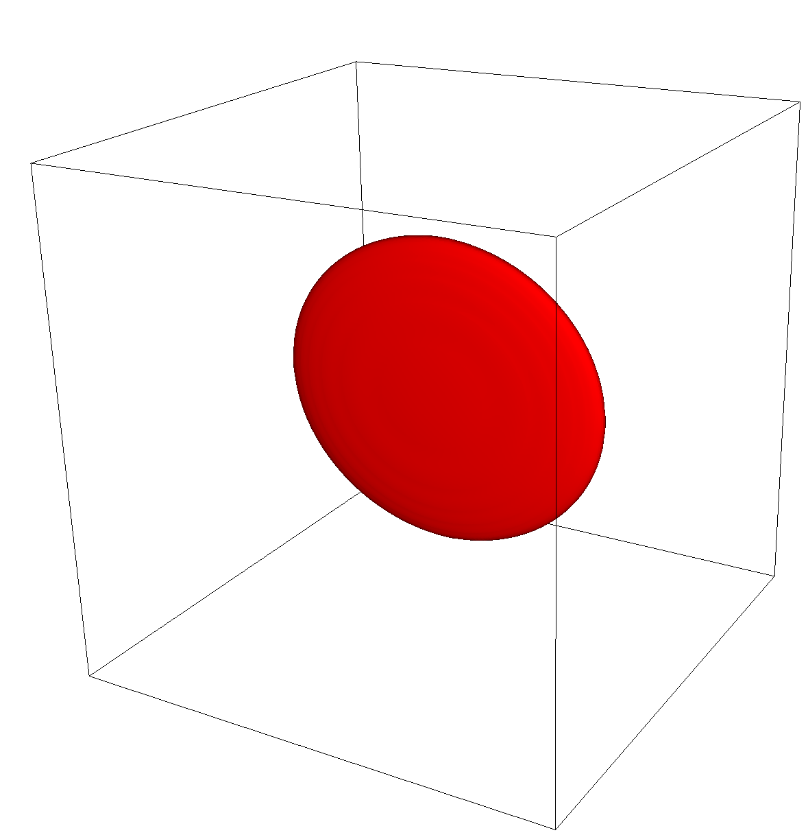
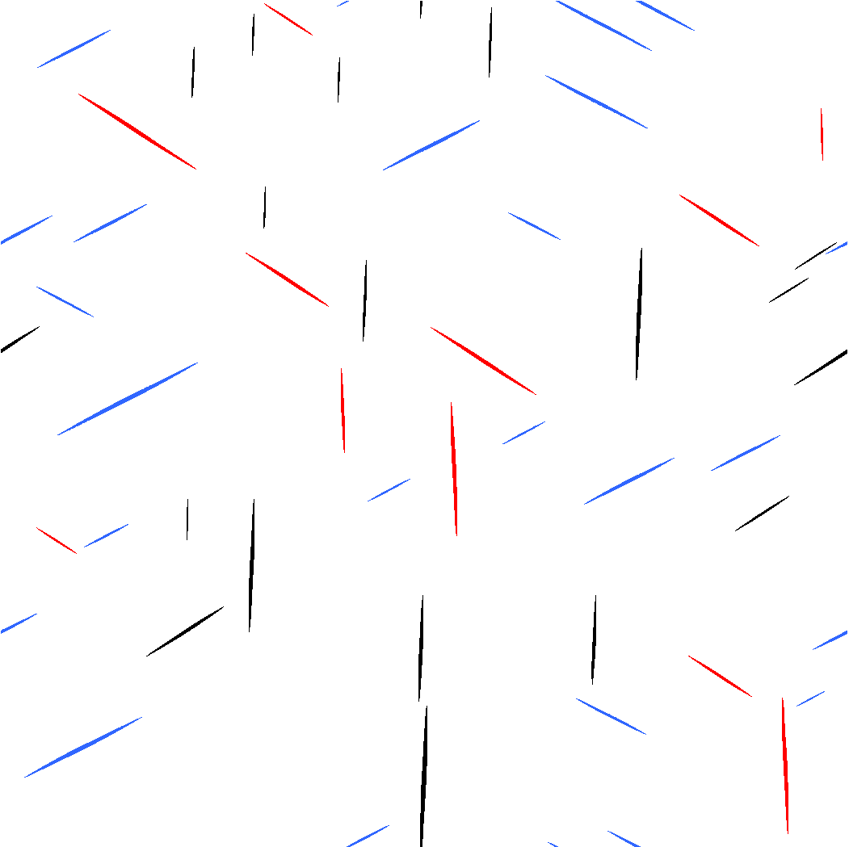
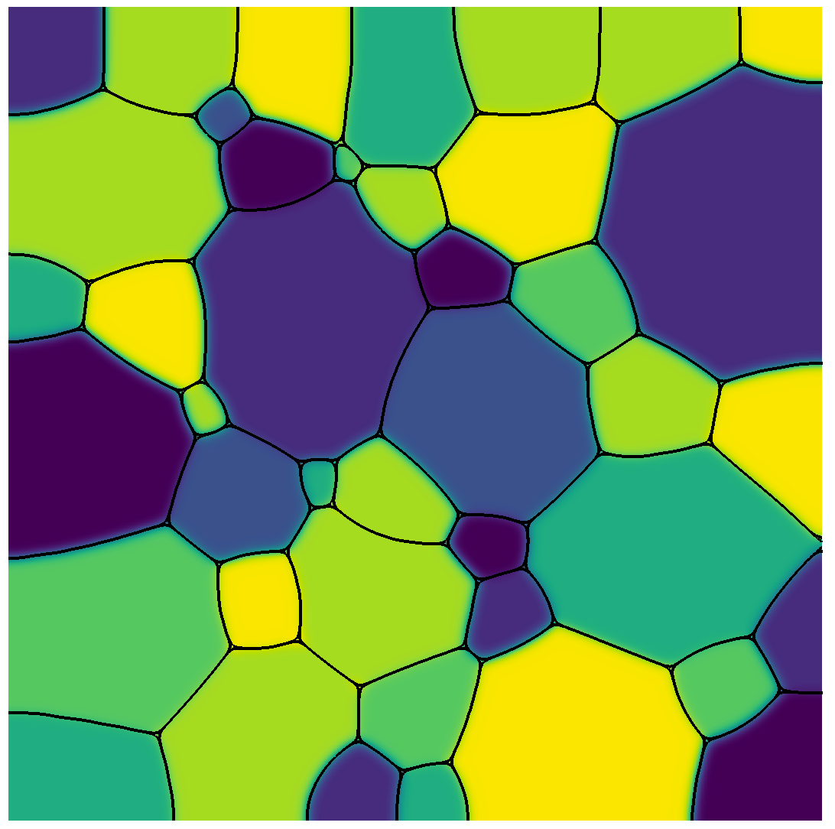
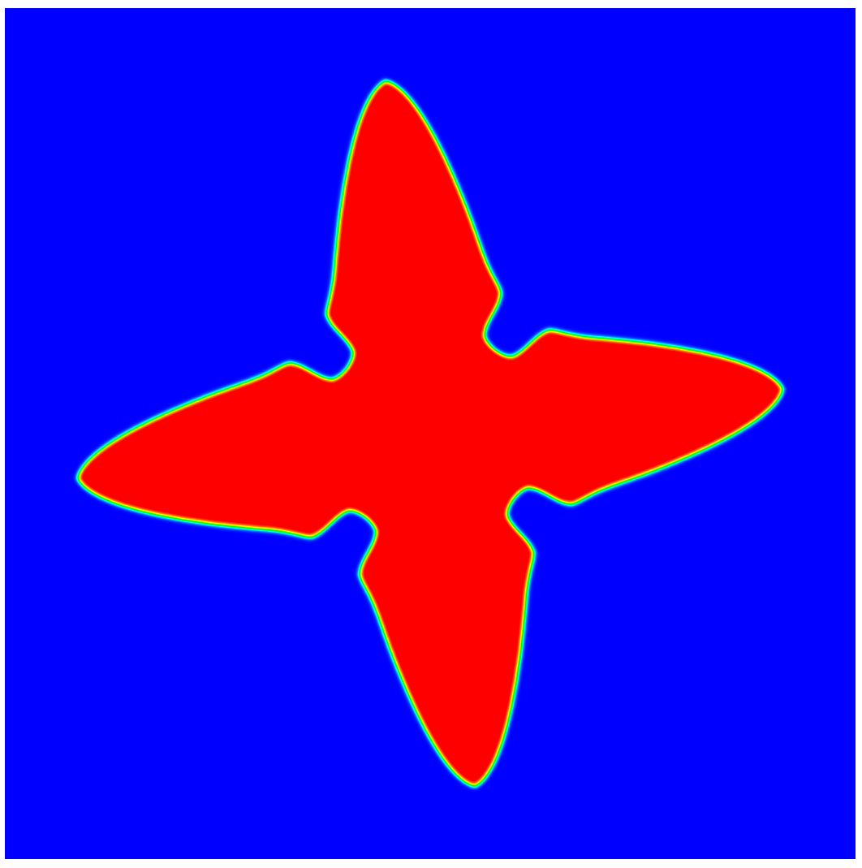
An Open Source, Finite Element,
General Purpose Phase-Field Platform
(prisms-center.github.io/phaseField)
Advanced Capabilities:
Matrix-free finite element approach
Higher-order elements
Multi-level parallelization:
MPI/Threads/Vectorization
Adaptive meshing
Explicit nucleus placement
Grain-remapping
Ease of Use:
Simple interface to solve an arbitrary number of coupled PDEs
Detailed online user guide
24 pre-built applications
Simple Docker-based installation
nanoHUB tool w/ GUI for educational use
Integrated with Materials Commons

Slide 9
Structure of PRISMS-PF
Core library
Generates mesh, does the finite element calculation, outputs files, etc.
Apps
Each app is a directory that contains an input file and some application files
Governing equations, boundary conditions, initial conditions, numerical and model parameters, postprocessing expressions
Using an app requires no C++ experience (parsed text input file)
Developing an app requires minimal C++ experience and no FEM experience
Tests
Suite of unit and regression tests
Continuous integration testing with Travis CI

Slide 10
Three Types of PRISMS-PF Users
Uses PRISMS-PF applications
No C++ knowledge needed
No deal.II knowledge needed
Creates PRISMS-PF applications
Minimal C++ knowledge needed
No deal.II knowledge needed
Extends PRISMS-PF itself
C++ knowledge needed
deal.II knowledge needed

Slide 11
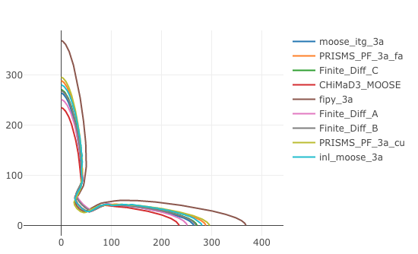
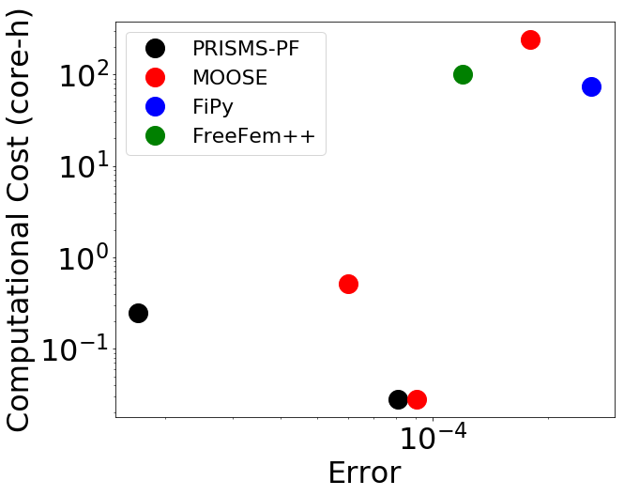
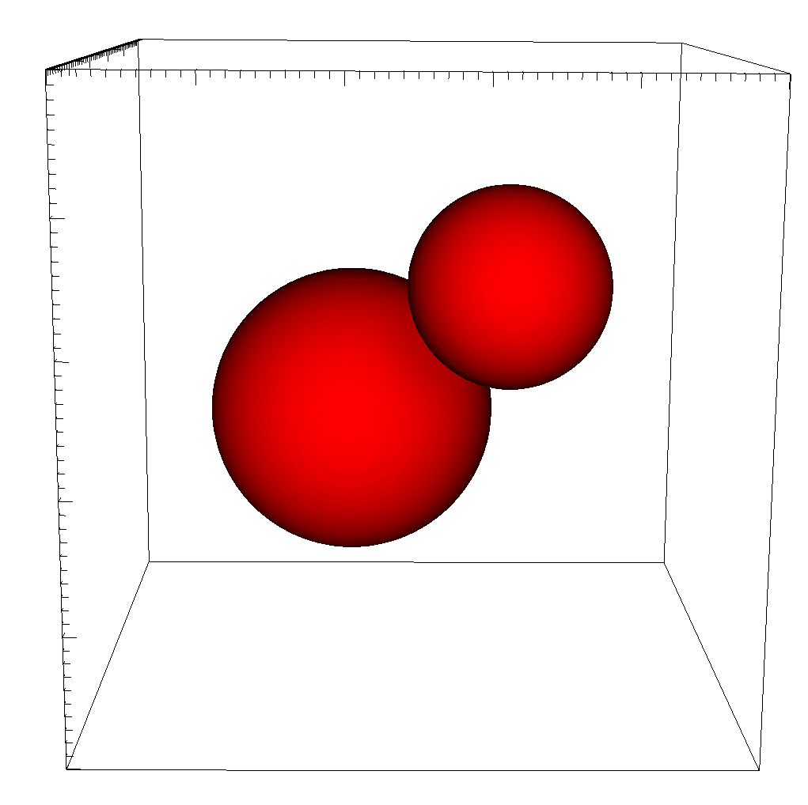
Performance of PRISMS-PF
Comparison vs. Finite Difference
Finite difference code
Fortran with MPI parallelization
2nd order central differences
Explicit time stepping
Two growing particles in 3D
Cahn-Hilliard/Allen-Cahn
Related to standard solidification and precipitation models
Comparison vs. Open Source Codes
PFHub dendritic solidification benchmark
Developed by the CHiMaD Center (NIST/Northwestern/Argonne)
Results uploaded to
https://pages.nist.gov/pfhub/
PRISMS-PF
PRISMS-PF Performance at Fixed Error*
Element/Mesh Type | Speedup vs. FD
Linear/Regular | 0.028
Quadratic/Regular | 0.90
Cubic/Regular | 1.9
Cubic/Adaptive | 12.0
*Equivalent to 5 pts. in the interface for FD

Slide 12
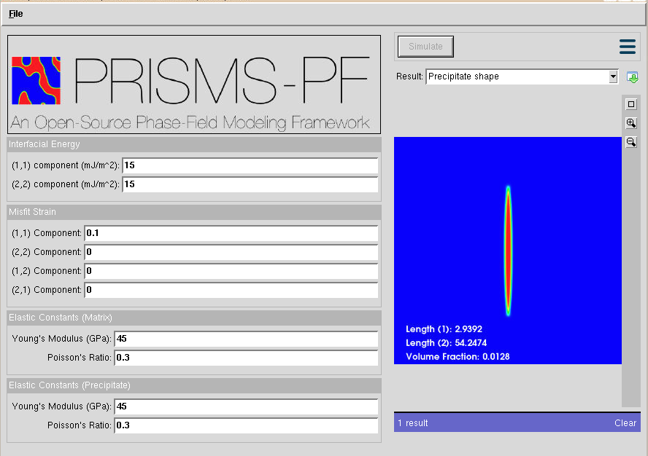
PRISMS-PF on nanoHUB (https://nanohub.org/tools/prismspfmisfit)
2D equilibrium shape of a precipitate, given misfit/interfacial energy/elastic constants
Targeted for classroom use
Companion worksheet being developed by Susan Gentry (UC Davis)

Slide 13
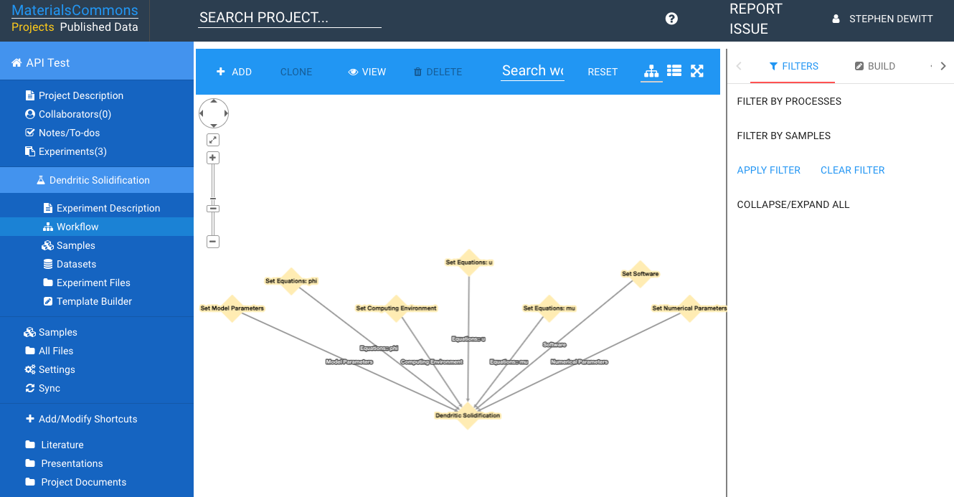
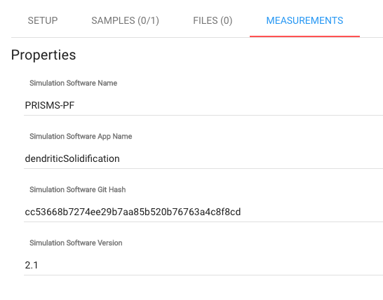
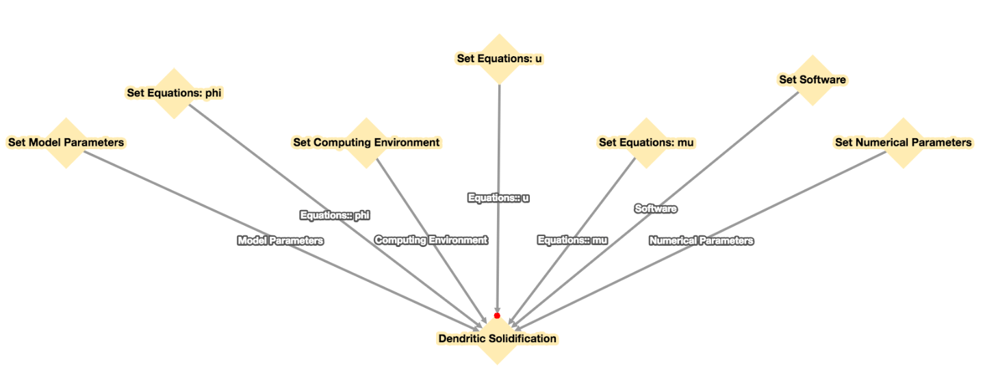
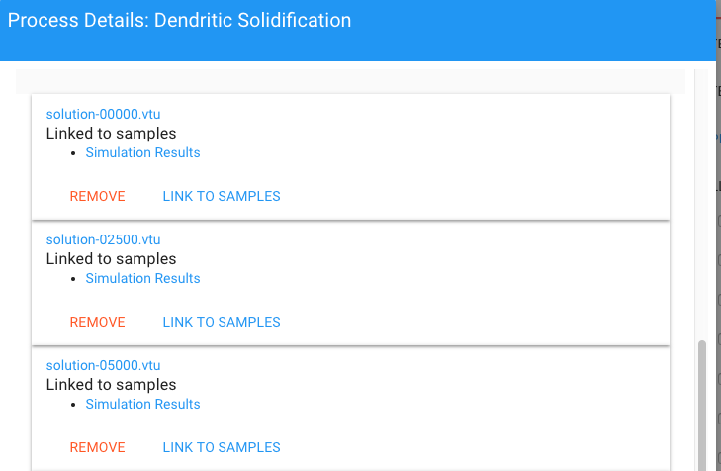
PRISMS-PF and Materials Commons
Command line tool automatically parses the PRISMS-PF app files and uploads the metadata and simulation results to Materials Commons

Slide 14
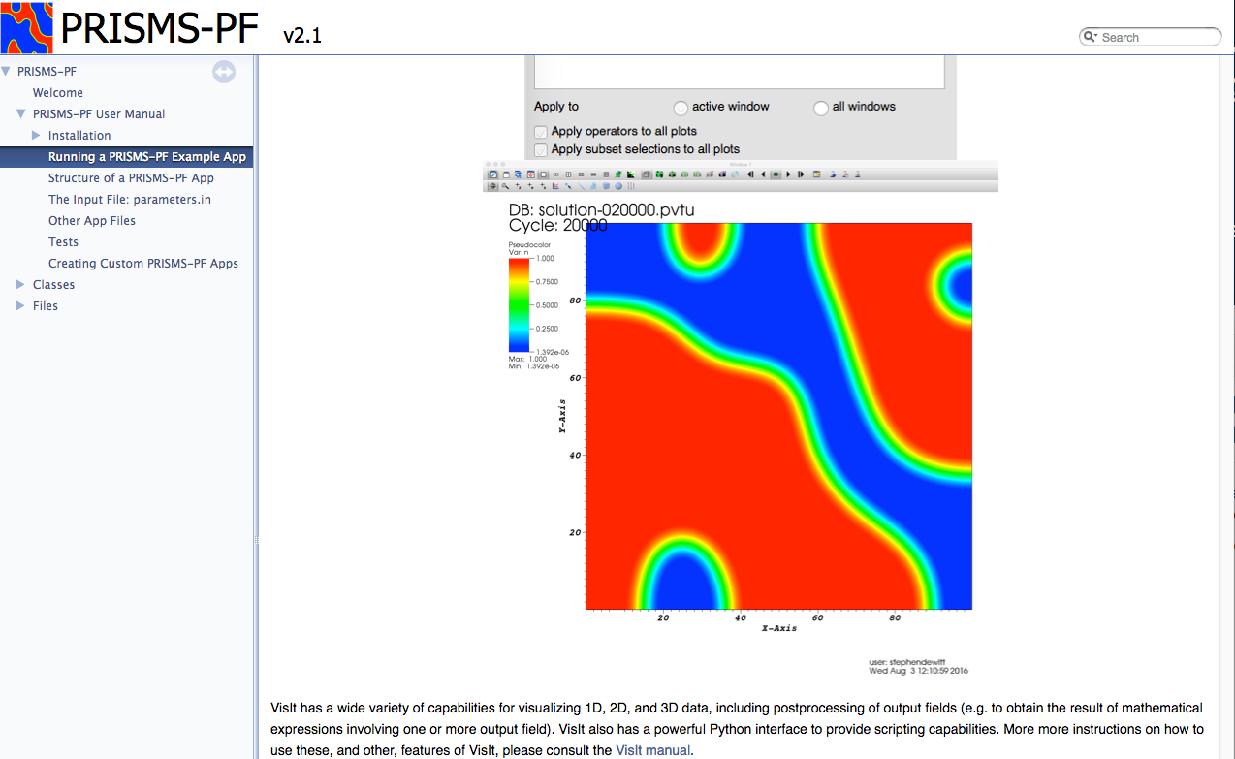
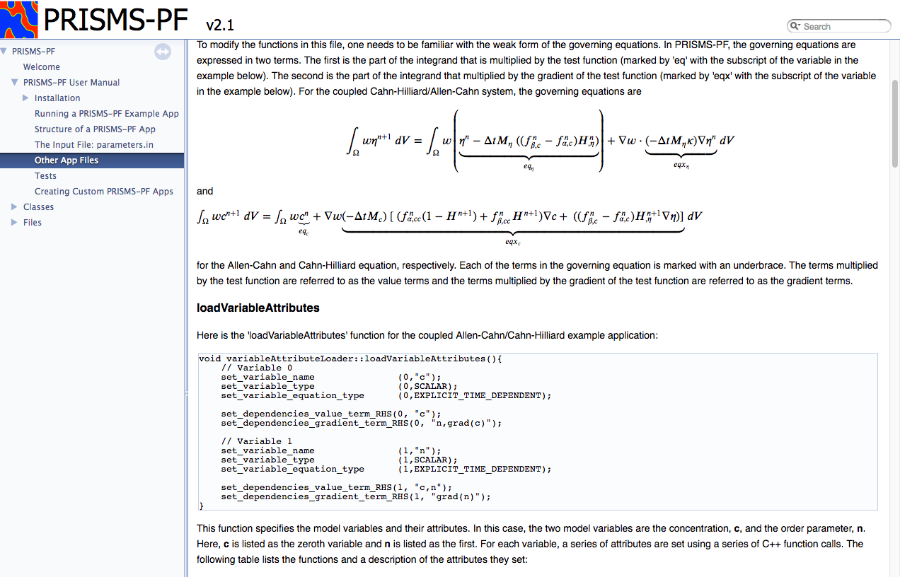
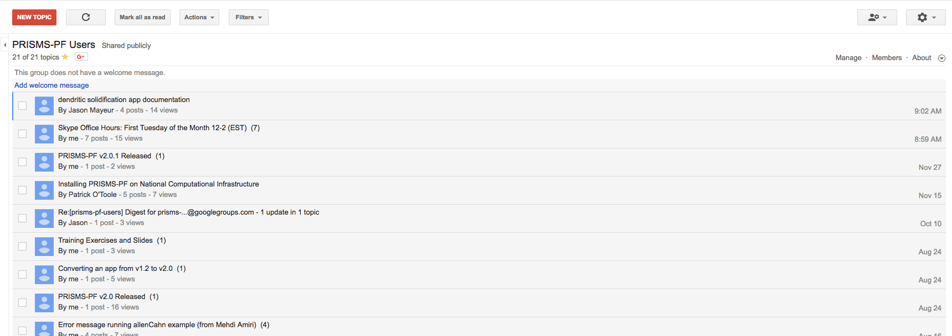

Community Support
Online user manual
Online forum
Monthly Skype office hours

Slide 15
Questions?

Slide 16
Downloading PRISMS-PF
https://github.com/prisms-center/phaseField

Slide 17
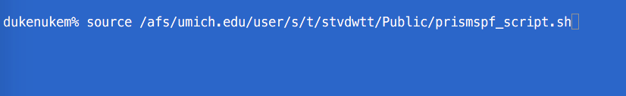
Setting Environment Variables
Type this on the command line:
source /afs/umich.edu/user/s/t/stvdwtt/Public/prismspf_script.sh

Slide 18
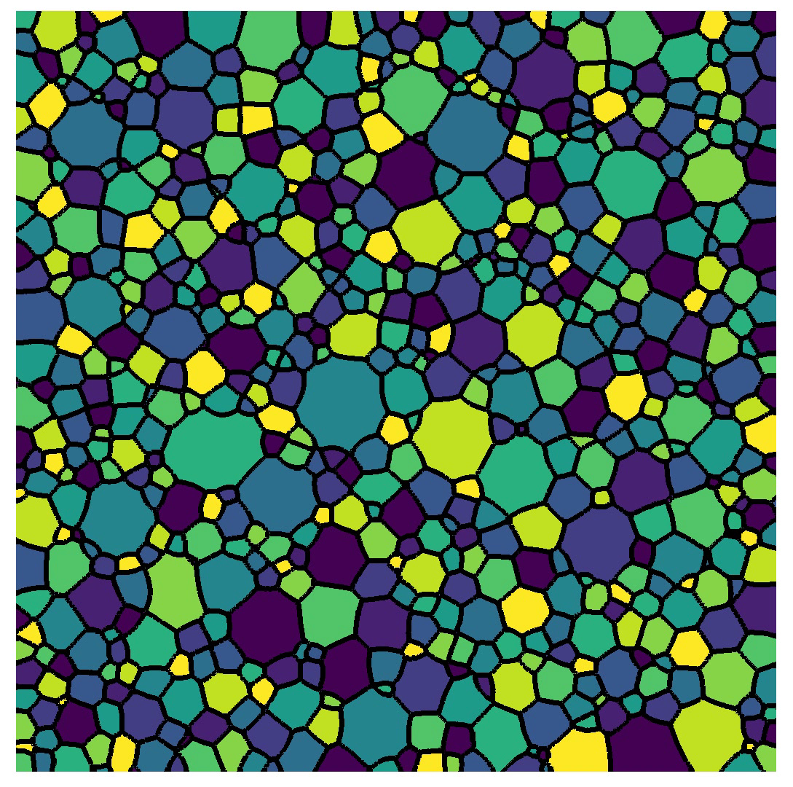

Grain Remapping in PRISMS-PF
A common use of phase field models is for polycrystalline systems
Naïve approach: one order parameter per grain (infeasible outside of toy problems)
Improved approach: Store multiple grains per order parameter and move them if they get close
Initial microstructure imported from

Slide 19
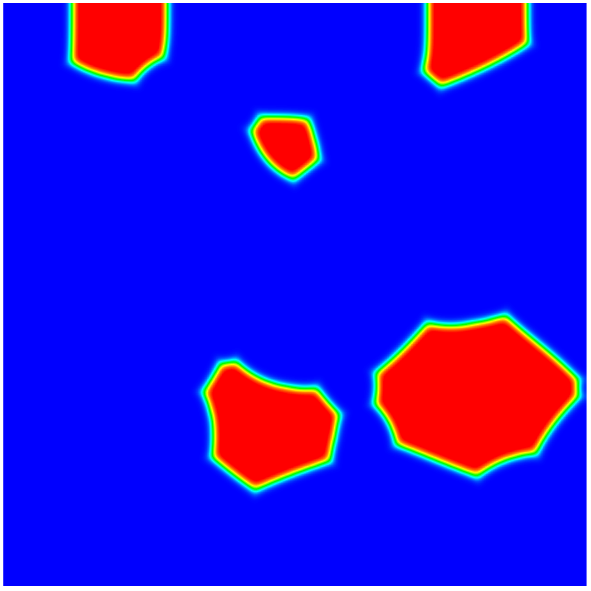
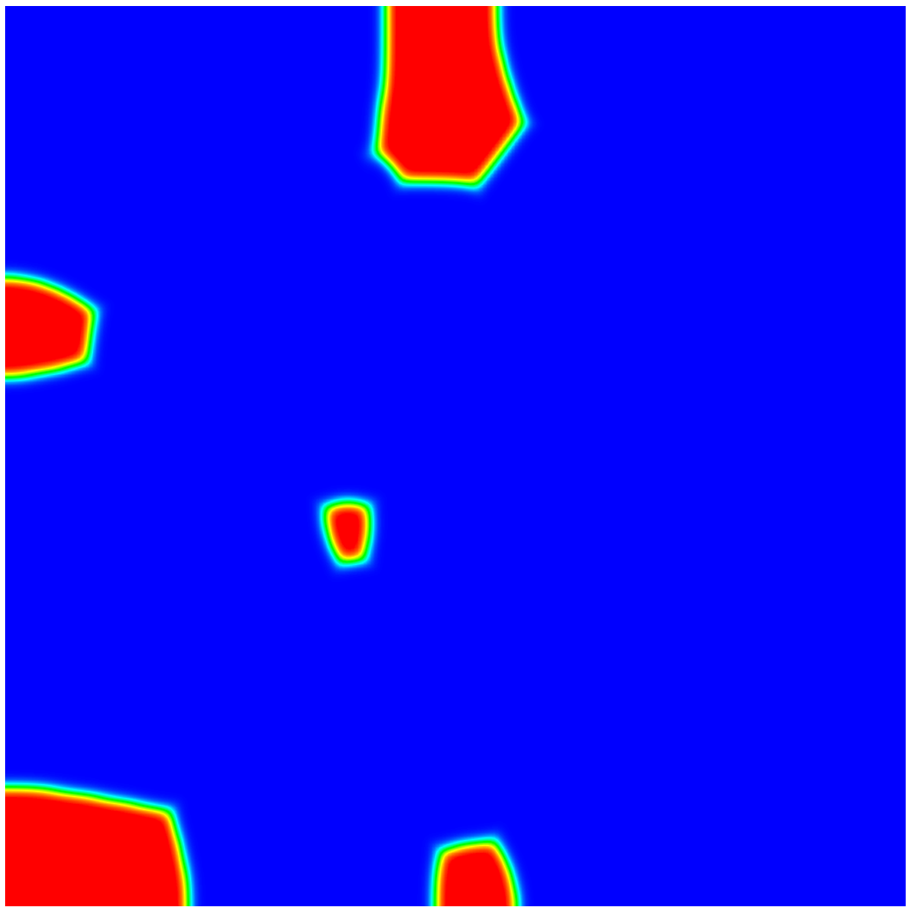
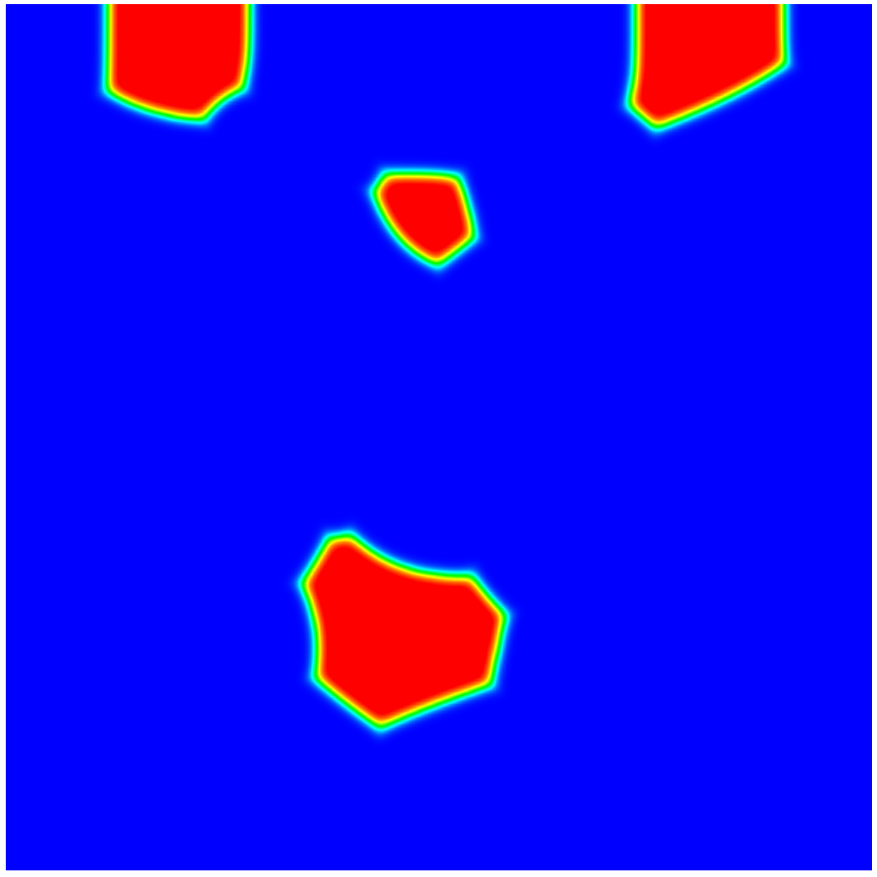
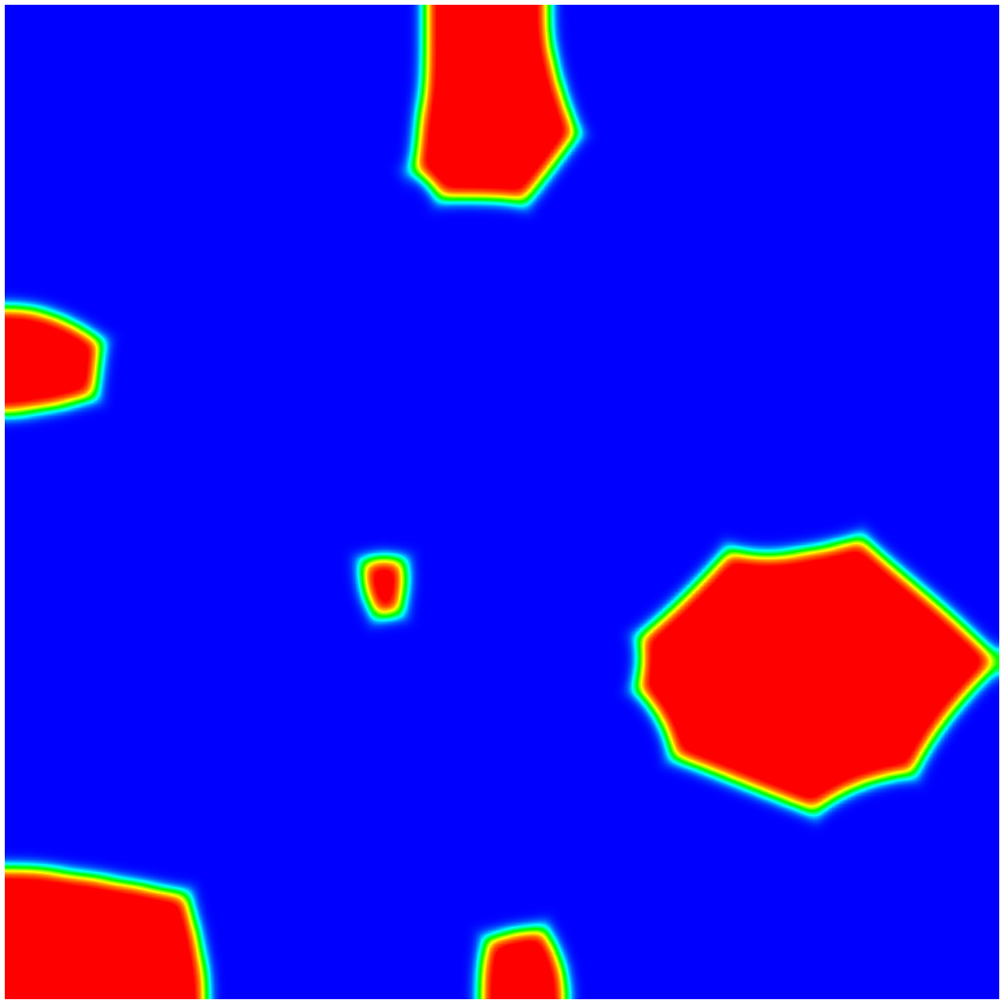
Grain Remapping in PRISMS-PF
Order Parameter 1
Order Parameter 2
Each grain is identified using a recursive flood fill
Simplified representation of each grain is stored
Currently a circle/sphere
A persistent grain ID is saved for each grain
Modified greedy coloring algorithm to determine the new home for a grain marked for transfer
Marked for transfer
Too close

Slide 21
Installing the Materials Commons Command Line Interface Tool
Type this on the command line:
source /afs/umich.edu/user/s/t/stvdwtt/Public/install_mccli.sh

Slide 22
Cloning a Materials Commons Project
Create a directory for your Materials Commons projects and enter it
$ mkdir mc_projects
$ cd mc_projects
View current Materials Commons projects
$ mc proj
Clone the project to your local machine
$mc clone [id of the project]

Slide 23
Creating a New Dataset
Enter the project directory
$ cd [project name]
Copy a PRISMS-PF app directory here
Either using ‘cp’ or the GUI
Enter that directory
$ cp [app name]
Parse the input files and upload the results
$ mc prismspf simulation --create --full-simulation --proc-name Dendritic Solidification --num-cores 8

